Slide 1

Super Zips Capstone Project
Milestone Report by Joseph Javier

Slide 2
Motivation and Problem Statement
This project intends to model which areas of the U.S. have improving(or worsening) overall standards of living over time.
My intended client would be government policymakers at all three levels (local, state, and federal) that would use my analysis and results in developing public policy. My project would serve as a reference and basis for implementing income/tax credits, subsidies, financial aid, public education programs, and other incentives supporting increases in education levels and eliminating poverty.

Slide 3
Methodology and Approach
Obtain source data to be cleaned and analyzed are income statistics publicly provided by the Internal Revenue Service and educational attainment data publicly provided by the U.S. Census Bureau. Calculating these two together as a ratio would measure the overall standard of living.
Predict areas of growing/contracting economic inequality by plotting the education and income based descriptive statistics over time for each zip code.
Use regression would predict how these statistics may change for a given number of years into the future.
Visualize these results by plotting a map of all the US zip codes with color gradients respective to education and income statistics. A slider bar or animation would be integrated into the visualization to show color changes/trends over time.

Slide 4
Data Wrangling Steps
Obtain main source data files needed from irs.gov and data.census.gov
Select relevant columns using documentation files provided with main source data files
Create subset data files from main source date files due to big source file sizes
Determine how to address missing data:
For the IRS AGI (Adjusted Gross Income) data, the missing data was filled in thanks to cross-referencing smaller data subset files divided from the main aggregate source file and grouped by state.
For the Census data, all rows containing missing data were removed from the dataset since certain estimates could not be calculated due to either no or too few observations as explained in the Symbols Dictionary
Re-define appropriate data types for all columns in data

Slide 5
Data Wrangling Steps (cont.)
Regroup/Tidy Data into a format appropriate for analysis using the .melt() and .pivot() dataframe methods
Calculate scores from raw data as described in the next slide. **EDA was not performed on the raw data due to file size and computational cost**
Perform EDA by the following steps and repeat for every year of data obtained (i.e. 2011-2018 for Census data and 2006-2017 for IRS AGI data)
Using .info() dataframe method to confirm numeric data uniformity and no missing data as well as data types
Use .describe() dataframe method to generate descriptive statistics and confirm data integrity
Plot a histogram to visualize distribution of all zip code scores from all 51 states
Use FacetGrid function from Seaborn to plot multiple swarmplots visualizing the score distributions by state
Create data analysis files suited for visualizations

Slide 6
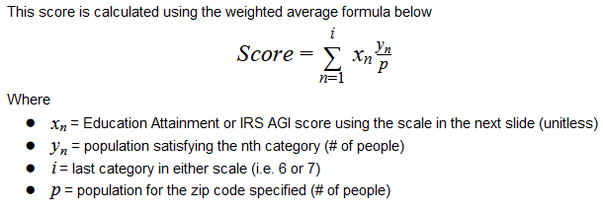
Calculating Education and Income Scores per Zip Code

Slide 7
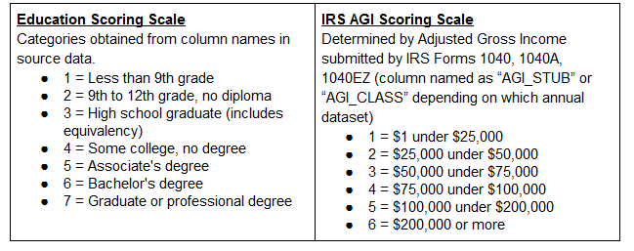
Scoring Scales

Slide 8
Data Storytelling
For this section, IRS AGI and Census Educational Attainment data are analyzed to answer the following questions below. Numerous plots were generated and can be viewed in this GitHub repo link to the Jupyter Notebook containing the analysis.
How are states and zip codes performing over time in terms of Educational Attainment and Income?
Which states and zip codes performing the best/worst over time in terms of Educational Attainment and Income?
Is there a relationship/correlation between Educational Attainment and Income?

Slide 9
How are states and zip codes performing over time in terms of Educational Attainment and Income?
Analysis and Outcome: After calculating the Education and Income scores for each zip code (column name is “ZipScore” in both IRS AGI and Census datasets), the scores were aggregated by arithmetic averaging on each State.
Examining high-level trends of 51 states is much easier than examining thousands of zip codes at once. Overall on average and upon visual inspection, everyone in the U.S. is gradually becoming more educated and earning more money to live better as shown in the next two slides across all states.
If upon visual inspection, I examine a state trending a certain way, I can then narrow in and look at the zip code trends within that state. As a result, this is done to answer the next question.

Slide 10
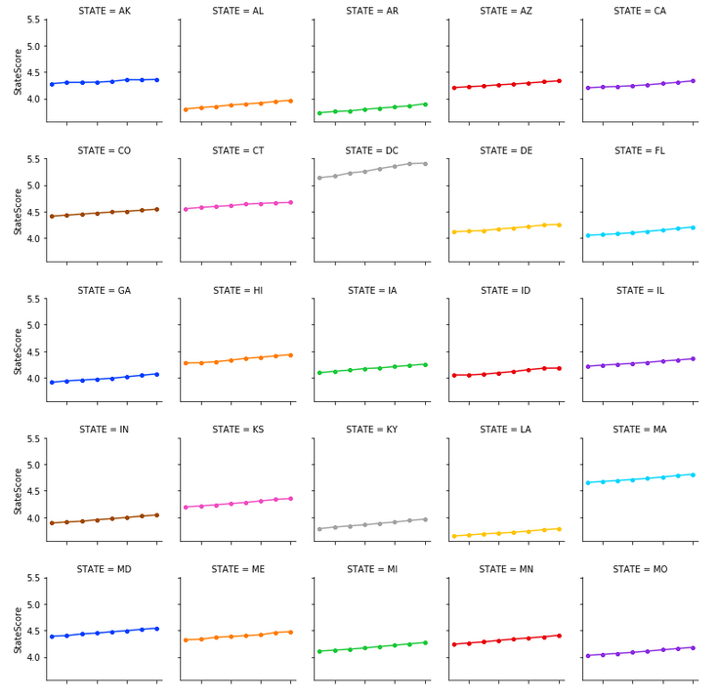
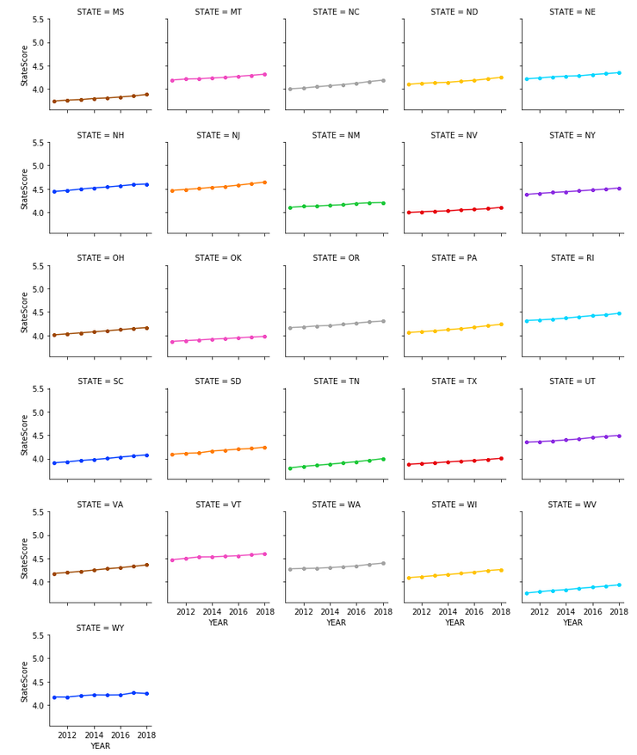
Education Score Trends by State

Slide 11
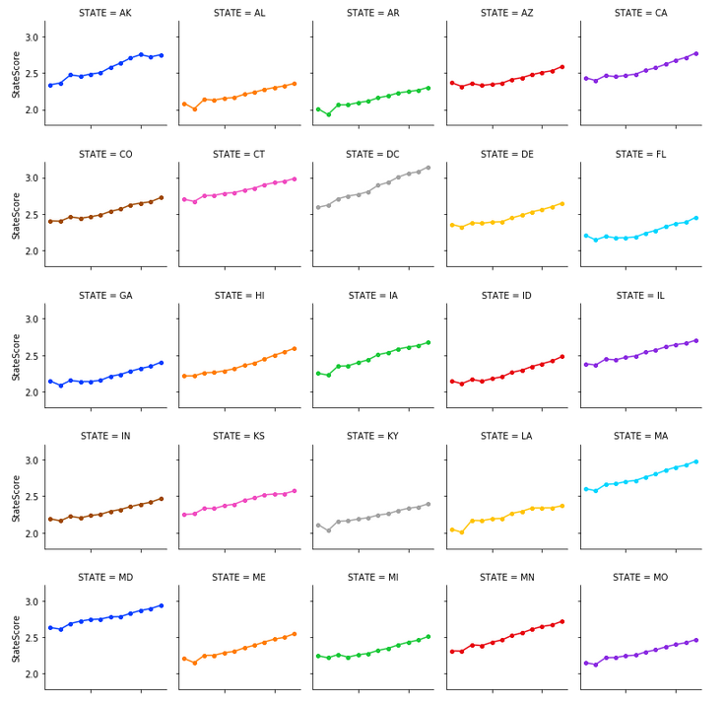
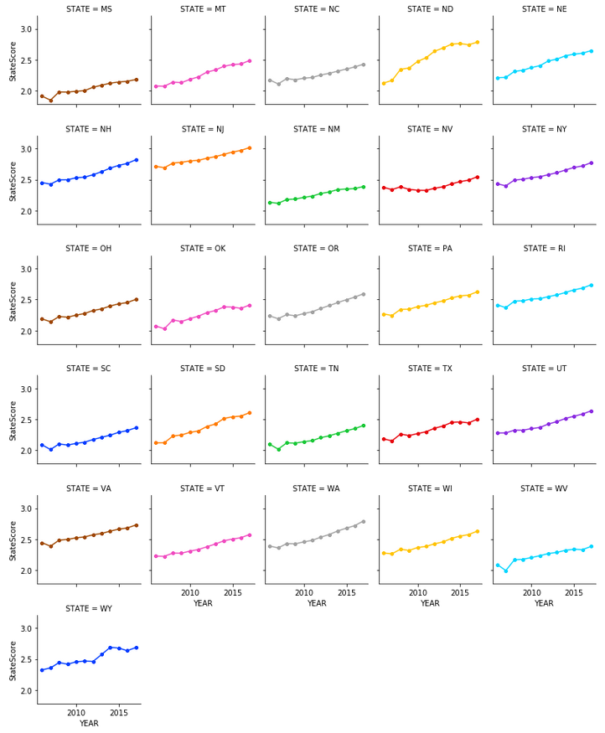
Income Score Trends by State

Slide 12
Which states and zip codes perform the best/worst over time in terms of Educational Attainment and Income?
Visually inspecting the line graphs in the previous two slides answers this question. The line graphs examining the zip codes for the following states are displayed in the Jupyter Notebook here.
education
income
District of Columbia (DC) has the highest Education scores and the steepest positive trend, thus performing the best. Narrowing in, we see that most zip codes are generally trending above a Education Score of 5 which is outside the range of the states (around 4-5).
Louisiana (LA) has the lowest Education scores and a gradual positive trend, but overall perform the worst. Narrowing in, we see that most zip codes are generally trending below a Education Score of 4 which is outside the range of the states (around 4-5).
District of Columbia (DC) has the highest Income scores and the steepest positive trend, thus performing the best. Narrowing in, we see that most zip codes are generally trending above a Income Score of 3 which is outside the range of the states (around 2-3).
Mississippi (MS) has the lowest Income scores and a gradual positive trend, but overall performs the worst. Narrowing in, we see that most zip codes are generally trending a little over a Income Score of 2 which is in the lower half of the range of the states (around 2-3).

Slide 13
For Education, DC and LA are selected

Slide 14
For Income, DC and MS are selected

Slide 15
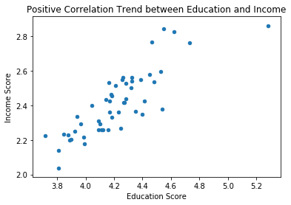
Is there a relationship/correlation between Educational Attainment and Income?
Analysis and Outcome: For this case, again, data was aggregated by State and not by Zip Code due to too many Zip Code data points resulting in a "blobplot" and not a scatter plot.
By combining the Census and IRS AGI data frames then using a scatter plot for the Education and Income Scores by State, we can see that there is certainly a positive relationship between the two.
In other words, the higher your education, the higher your income.

Slide 16
Statistical Data Analysis
This section summarizes the steps and corresponding results of performing Statistical Data Analysis on Education (obtained from the US Census) and Income (obtained from the IRS) data.
For this analysis, these two variables are defined to be the primary factors of an area’s overall standard of living. Also, they’re shown to be linearly related and vary together.
**Only 2011 and 2017 data are used due to intersection of annual releases of datasets**

Slide 17
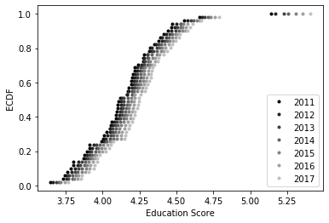
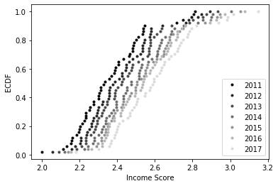
Step 1: Conduct EDA
Plot ECDFs for all years available for Education and Income Scores with color variation to show change over time.
Results and Findings: The ECDF plots for Education and Income Scores show gradual shifts to the right over time as indicated by the color variation from black to light gray. This is a good sign that overall people are gradually becoming more educated and earning more money to live better.

Slide 18
Step 2: Parameter Estimation
Estimate the difference of the mean Education and Income Scores of all zip codes from 2011-2017.
Results and Findings: Difference of Education Score means = 0.126 and Difference of Income Score means = 0.231, which shows, on average, how much the Education and Income scores have changed in 7 years (including the year of 2017).

Slide 19
Step 3: Confidence Interval Calculation
Use Bootstrap replicates method for 2011 and 2017 datasets only for both Education and Income scores to report a 95% bootstrap confidence interval.
Results and Findings:
95% bootstrap Conf. Int. bounds of Education Scores = [0.112 0.140]
95% bootstrap Conf. Int. bounds of Income Scores = [0.221 0.241]
These bounds show the Confidence Interval containing the differences of means of Education and Income estimated in Step 2.

Slide 20
Step 4: Hypothesis Testing
Answer the question, “Have Education and Income Scores improved?” (i.e. Null Hypothesis: Mean of 2017 – Mean of 2011 = 0, Alternate Hypothesis: Mean of 2017 – Mean of 2011 > 0) by performing a bootstrap permutation test by shifting the two data sets so that they have the same mean and then use bootstrap sampling to compute the difference of means.
Results and Findings: The p-values for both bootstrap hypothesis tests are so small that Python essentially returns zero resulting in statistical signifying that the null hypotheses for both Education and Income can be rejected. Thus, the two means are different which indicate change between 2011 and 2017.

Slide 21
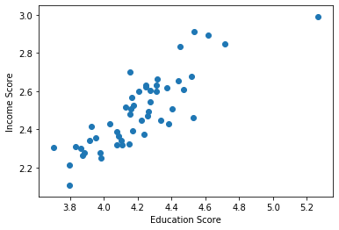
Step 5: Correlation and Covariance Analysis
Calculate Pearson correlation coefficient and covariance between Education Scores and Income Scores from 2011-2017 (confirm relationship between Education and Income).
Results and Findings: The scatterplot suggests, at first glance, that there is a positive relationship between Education and Income plus the two variables vary together.
This is confirmed by calculating the Pearson Correlation Coefficient (r = 0.845, confirm the strong relationship) and Covariance (cov = 0.044) between the two sets of scores.

Slide 22
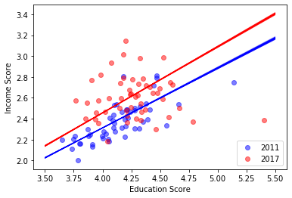
Step 6: Linear Regression
Perform a linear regression for both the 2011 and 2017 data. Then, perform pairs bootstrap estimates for the regression parameters. Report 95% confidence intervals on the slope and intercept of the regression line (show how Education and Income change together over time).
Results and Findings:
2011: slope = 0.573, conf int = [0.565 0.580]
2011: intercept = 0.020, conf int = [-0.007 0.052]
2017: slope = 0.634, conf int = [0.626 0.642]
2017: intercept = -0.079, conf int = [-0.112 -0.047]
Calculating these bootstrap results quantify how Education and Income change together over time. These are shown visually from the combined line and scatter plot below as the regressing line changes from 2011 to 2017.

Slide 23
Step 7: Calculate 95% bootstrap confidence interval for overall standard of living
Compare the mean ratio of Education Scores to Income Scores.
Results and Findings:
2011: mean ratio = 1.750, conf int = [1.747 1.753]
2017: mean ratio = 1.644, conf int = [1.641 1.647]
These results suggest changes in overall standard of living over 7 years (including the year of 2017) and even the confidence intervals overlap. To confirm, bootstrap hypothesis testing is done in the next and final step.

Slide 24
Step 8: Bootstrap hypothesis testing on ratios
Perform a bootstrap permutation test (like in Step 4) by shifting the two data sets so that they have the same mean. Then use bootstrap sampling to compute the difference of means.
Results and Findings: The p-value for the bootstrap hypothesis tests are so small that Python essentially returns zero resulting in statistical signifying that the two means are different. This indicates a change in overall standard of living between 2011 and 2017.

Slide 25
In-Depth Analysis
For this section, machine learning was used to draw insights from the Education Attainment and Income score data generated previously.
Hypothesis: The data can be clearly categorized into clusters similar to the economic classes (i.e. lower class, middle class, upper class, etc.).
Conclusion: The above hypothesis was proven false. Instead, all the data forms a single cluster, but an opinion is also proposed on how clustering may be used and interpreted.
**Education and Income Scores are the two primary variables of interest, these will be the two main features and no PCA/Dimensionality Reduction is required.**

Slide 26
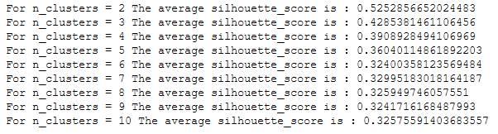
Step 1: Conduct Silhouette Score Analysis
Calculate Silhouette Scores and generate Silhouette Samples to determine best value of K for K-Means clustering.
Results and Findings: The silhouette score decreases then settles around 0.325 with increasing K which is undesirable. However, I personally chose K = 5 as explained in the next section.

Slide 27
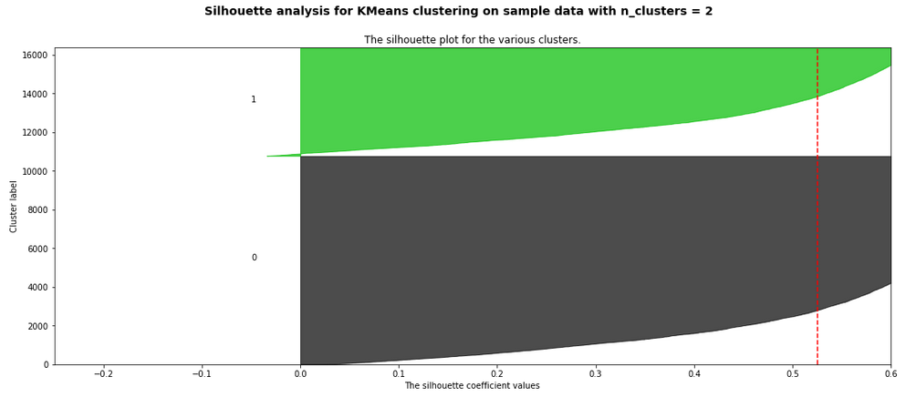
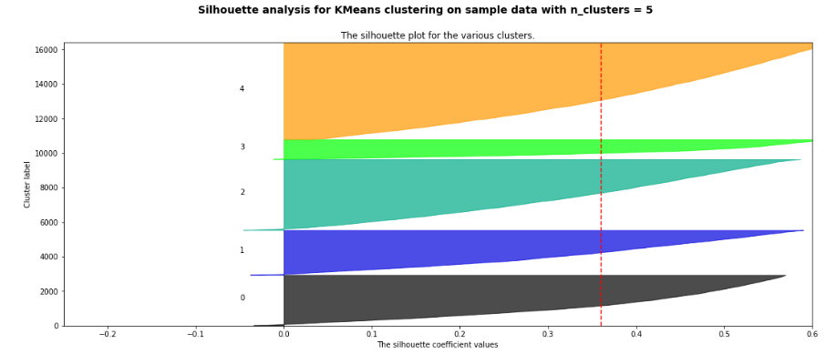
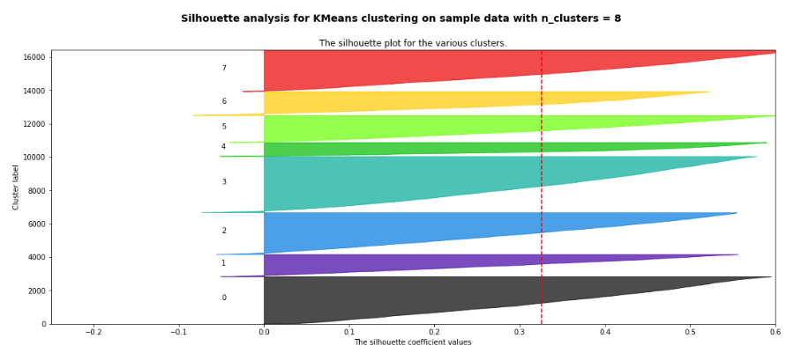
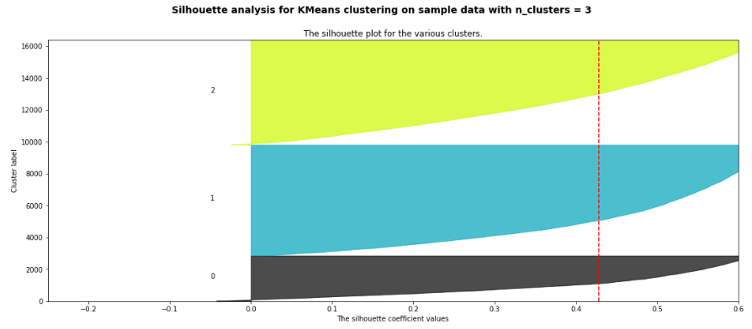
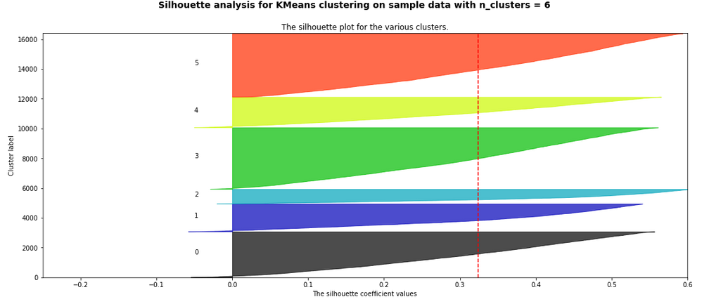
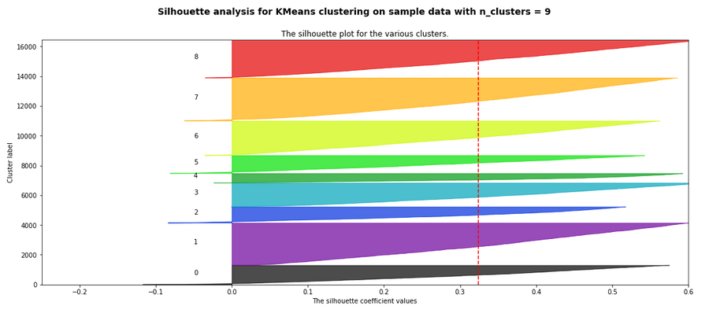
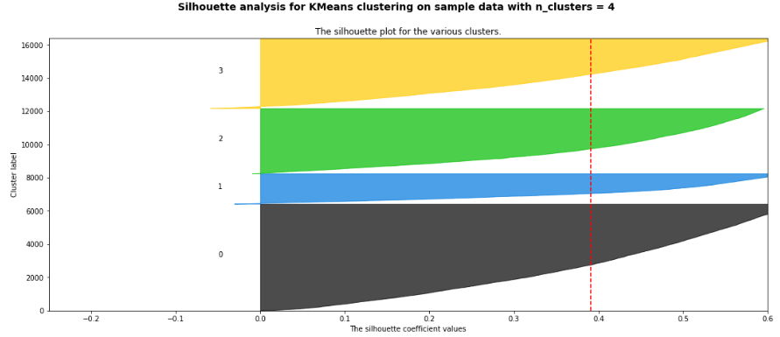
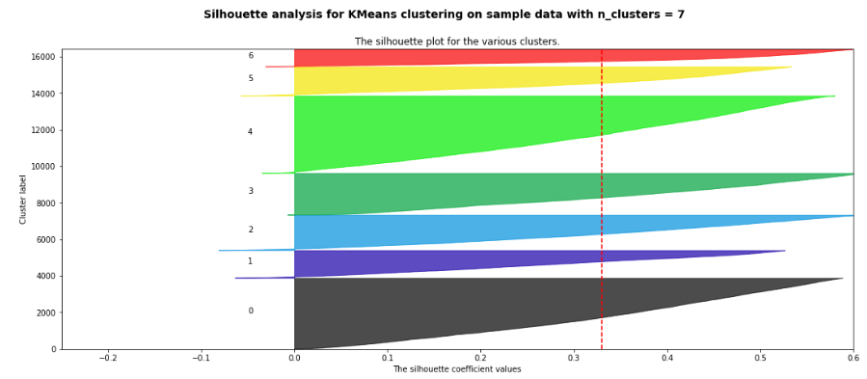
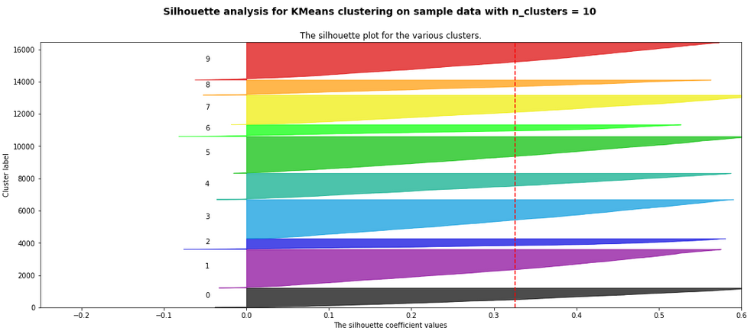
Silhouette Score Plots

Slide 28
Step 2: Conduct K-Means Clustering with Five Clusters for 2011 and 2017 data
K = 5 was chosen as analogous labeling categories to the five economic classes: Lower, Lower-Middle, Middle, Upper-Middle, and Upper. Similarly, these clusters are labelled Classes 1-5 with Class 1 having the lowest Standard of Living (SoL) and Class 5 having the highest SoL.
I considered this labelling scheme not from an objective, logical perspective where there are concrete, easily definable boundaries but from a subjective, emotional perspective based on peoples' broad, spectrum-like perception of how much a person should be paid based on the same person's level of education.
Another way of thinking about this is what is the expected sentimental value of a zip code (Education Score) vs. what is the actual sentimental value of a zip code (Income Score).

Slide 29
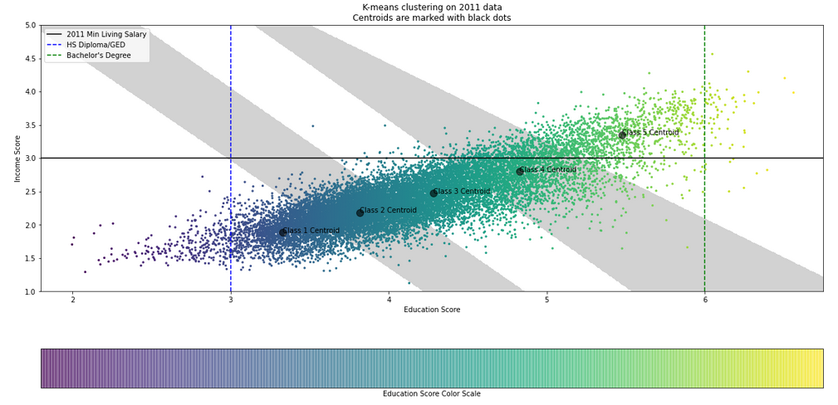
Results and Findings for Clustering 2011 Data
In 2011, we see that the majority of zip codes are earning less than the 2011 Minimum Living Salary (approx. $50,000 which is equivalent to a Income Score of 3, Source: Statista - US Annual Consumer Expenditures). What is also troubling to see is a small portion of zip codes in the upper right sextant of the scatter plot. Personally, I never realized growing up that the majority of Americans are being paid and educated lower than the common standards stated earlier. I just presumed that everyone was more/less achieving the common standards since the U.S. is a developed country and considered a superpower.

Slide 30
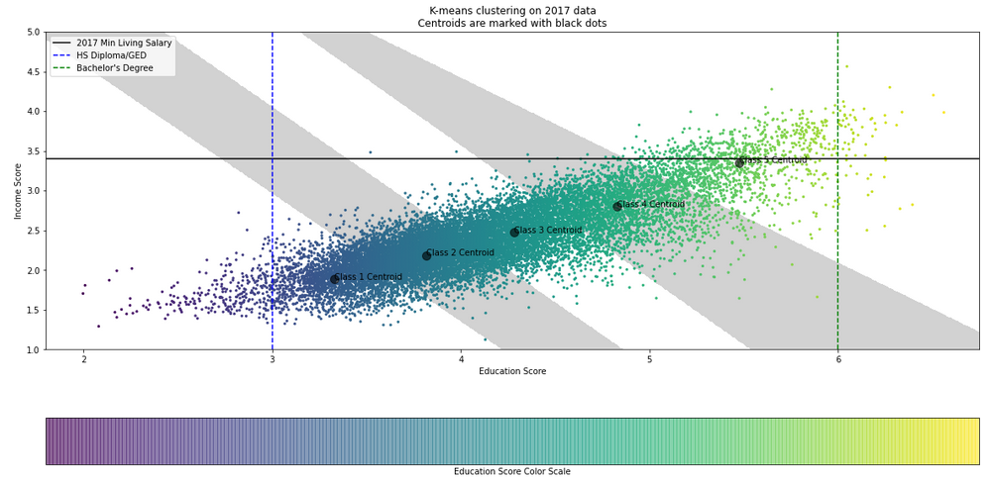
Results and Findings for Clustering 2017 Data
In 2017, we see that even more zip codes are earning less than the 2017 Minimum Living Salary which is $10,000 higher (approx. $60,000 which is equivalent to a Income Score of 3.4, Source: Statista - US Annual Consumer Expenditures). We also see that the clusters and centroids themselves changed only a little but although people are earning more and becoming more educated, this rate of increasing income is slower than the rate of increasing minimum livable salary. These small changes in clusters will unfortunately reinforce the common notions even though drastic change is needed.

Slide 31
Step 3: Draw Conclusions
Even though the previous notebooks of this project show optimism, everyone must understand the reality of the situation the everyday American is facing now and not turn a blind eye. These findings show evidence of growing economic inequality in this country and should inform everyone how our general view of success and the American Dream will change.

Slide 32

Hope this project was informative!!

